Slide 1
Social Network Analysis
Game Theory
Prof. Keeheon Lee
TA. Jaekeun Lee
010-5599-9411
agdal1125@gmail.com

Slide 2
Table of Contents
- Games
- Evolutionary Game Theory
- Modeling Netowkr Traffic Using Game Theory

Slide 3
Games

Slide 4
Definition of Game
Basic components of a Game
  a set of participants are called players
  each player has a set of options for how to behave: possible strategies
  for each choice of strategies, each player receives a payoff that can depend on other player’s strategies

Slide 5
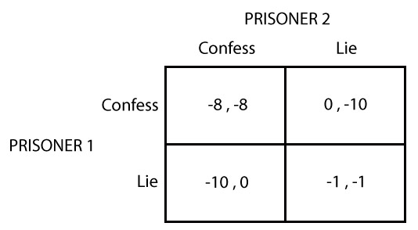
Reasoning about Behavior in a Game
Underlying Assumptions
  Everything that a player cares about is summarized in the player’s payoffs
  Each player knows everything about the structure of the game
  Individual chooses a strategy to maximize his or her own payoff - rationality
Prisoner’s Dilemma
  Problem that discuss complexity and difficulty in establishing cooperation in the face of individual self-interest

Slide 6





Best Responses and Dominant Strategies
Best Response
The best choice of one player, given a belief about what the other player will do.
If, one choice is uniquely the best against, it is called strict best response*
$$P_{1}\left(S,T\right)≥P_{1}\left(S^{′},T\right)$$
*$P_{1}\left(S,T\right)>P_{1}\left(S^{′},T\right)$
$S$ = strategy chosen by player1
$T$ = strategy chosen by player2
$P_{1}$ = payoff to player 1
Dominant Strategy
Strategy that is a best response to every strategy of the other player

Slide 7
Nash Equilibrium
When neither player in 2-player game has a strictly dominant strategy, there is another way to predict what is likely to happen
If player 1’s strategy is S and player 2’s strategy is T and both are equally best responses to each other, these pair of strategies is a Nash Equilibrium
No players have incentives to deviate from this Equilibrium.
$${Prisoner}_{1}\left(Confess,Lie\right)>{Prisoner}_{1}\left(Lie,Lie\right)$$
0
-1
$${Prisoner}_{1}\left(Confess,Confess\right)>{Prisoner}_{1}\left(Confess,Lie\right)$$
-8
-10
The outcome is same for prisoner2. Thus, for both players, confess is a strictly dominant strategy, and the Nash Equilibrium establishes at (Confess, Confess)

Slide 8
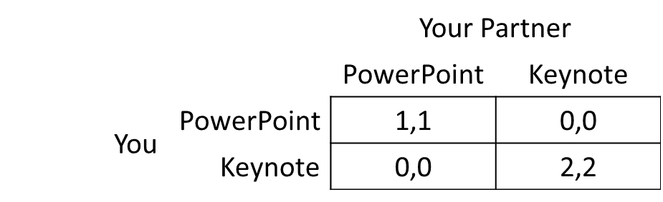
Multiple Equilibria: Coordination Games
For a game with a single Nash Equilibrium, it is predictable that the players will play the strategies in this equilibrium
Some games however, there are multiple Nash equilibrium, which makes it difficult to predict how rational players will behave in the game
Coordination Game
two player’s shared goal is really to coordinate on the same strategy
Social convention can play an important role when choosing a strategy
ex) drivers turn handle right when about to collide (US)
drivers turn handle left when about to collide (UK)

Slide 9
Matching Pennies – zero sum game
Players simultaneously reveal a penny
If both pennies show heads or tails, player 1 pays player 2
If both pennies are different, player 2 pays player 1
zero sum game: game with property that the payoffs of the players sum to zero in every outcome
 |  | Player 2
 |  | Heads | Tails
Player 1 | Heads | -1, 1 | 1 , -1
 | Tails | 1 , -1 | -1, 1

Slide 10
Pure Strategy vs Mixed Strategy
Pure Strategy
A complete plan of action for playing a game
Select a single action and play it
Mixed Strategy
Randomize over the set of actions in relevance to probability distribution
Players chooses to “randomize” between pure strategies
Equilibrium in mixed strategies is to decide in accordance to expected payoff

Slide 11
Finding all Nash Equilibria
For a game with a single Nash Equilibrium, it is predictable that the players will play the strategies in this equilibrium
Some games however, there are multiple Nash equilibrium, which makes it difficult to predict how rational players will behave in the game
Coordination Game
two player’s shared goal is really to coordinate on the same strategy
Social convention can play an important role when choosing a strategy
ex) drivers turn handle right when about to collide (US)
drivers turn handle left when about to collide (UK)

Slide 12
Pareto Optimality and Social Optimality
Social Optimality
A choice of strategies is social-optimal, or social welfare maximizer if it maximizes the sum of the player’s payoffs
Pareto Optimality
A choice of strategies is pareto-optimal if there is no other choice of strategies where all players receive payoffs as least as high, and at least one player receives a strictly higher payoff

Slide 13
Evolutionary Game Theory

Slide 14

Evolutionary biology & Game Theory
Many behaviors involve the interaction of multiple organisms in a population
The success of any one of these organisms depend on how its behaviors interacts with that of others
Organism’s genetically determined characteristics and behaviors are like its strategy in a game
Fitness acts as a payoff, and the payoff depends on the characteristics (strategies) of the organisms
Individuals cannot choose their strategy.. it is inherited
 |  | Beetle 2
 |  | Small | Large
Beetle 1 | Small | 5 , 5 | 1 , 8
 | Large | 8 , 1 | 3 , 3
Payoff matrix summarizing what happens when two beetles compete for food*
* However, each beetles are already genetically wired, and cannot change their size. The idea of choosing strategy is rather done in a longer time scale.

Slide 15
Evolutionarily Stable Strategies
Evolutionarily stable strategy
a genetically determined strategy that tends to persist once it is prevalent in a population
when a whole population is using the strategy and any small group of invaders using a different strategy will eventually die off over multiple generations
reproduction and survival is objective, and individuals are subject to the forces of natural selection with the payoffs of the game
Nash Equilibrium that is “evolutionarily stable”

Slide 16
Modeling Network Traffic Using Game Theory

Slide 17
Traffic at Equilibrium
Traveling through a transportation network, or sending packets through the Internet, involves fundamentally game-theoretic reasoning: individuals must evaluate routes in the presence of congestion resulting from the decisions made by themselves and others
C
x/100
45
A
B
45
D
x/100
A-C, B-D are sensitive to congestion: takes x/100 minutes
A-D, B-C are insensitive to congestion: takes 45minutes
When 4000 cars want to get from A to B, X = 2000 is the Nash Equilibria.
Travel time is 65 (45 + 2000/100 )

Slide 18

Braess’s Paradox
Adding resources to transportation network does not always increase efficiency.
It might hurt performance at equilibrium.
In Korea, destruction of 6-lane highway to build a public park actually improved travel time into and out of the city
C
x/100
45
A
0
B
45
D
x/100
All cars will use the route through both C and D
When 4000 cars want to get from A to B, X = 4000 is the Nash Equilibria.
Travel time is 80 (4000/100 + 0 + 4000/100 )

Slide 19




Social Cost of Traffic at Equilibrium
Travel Time Function of edge e : $T_{e}\left(x\right)$
Travel Pattern: Choice of a path by each driver
Social Cost: sum of the travel times incurred by all drivers in accordance to the travel pattern
Equilibrium always exists
Equilibrium has more social cost than that of the social optimum (twice at most)
C
A
B
C
D
Socially optimal
$$T_{AC}\left(x\right)=x$$
$$T_{CB}\left(x\right)=5$$
A
B
C
$T_{AD}\left(x\right)=$5
D
$$T_{DB}\left(x\right)=x$$
A
B
Nash Equilibrium
D

Slide 20
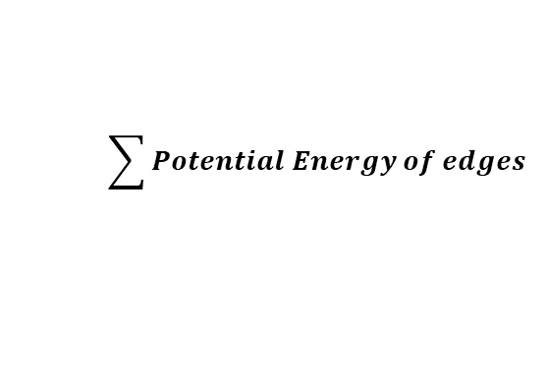
Finding a traffic pattern at Equilibrium
Best response dynamics
- If no player can do better → Equilibrium
- If at least one player can change → Reconfigure the player’s strategy to the better one
Potential Energy:
Progress measurement that is used to track the process of the operation of best response dynamics. It decreases as best-response is updated by player
Potential Energy of an edge:
Cumulative quantity based on the assumption that drivers cross the edge one by one, and each driver only feels the delay caused by himself and the drivers who cross the edge in front of him
$T_{e}\left(1\right)+$ $T_{e}\left(2\right)+T_{e}\left(3\right)+ …+T_{e}\left(n\right)$
$$\sum{Potential Energy of edges}$$
Potential Energy of traffic:
Sum of the potential energies of all the edges

Slide 21
Finding a traffic pattern at Equilibrium
C
1+2
5+5
A
B
C
5+5
1+2
D
$$T_{AC}\left(x\right)=x$$
$$T_{CB}\left(x\right)=5$$
Potential Energy
A
B
C
$T_{AD}\left(x\right)=$5
D
$$T_{DB}\left(x\right)=x$$
1+2+3
5+5+5
A
B
5+5+5
1+2+3
D

